Slide 1

Operating systems
Lecture # 03

Slide 2
Lecture Overview
Process States in Operating Systems
New / Create
Ready / Suspend Ready
Runing / Not Runing
Wait / Block – Suspend Wait
Long/Short/Medium Term Schedular
Allocation / Deallocation
Terminated

Slide 3
Process Concept
A process is a program under execution that consists of a number of elements including, program code and a set of data. To execute a program, a process has to be created for that program. The process may or may not run but if it is in a condition of running then that has to be maintained by the OS for appropriate progress of the process to be gained.

Slide 4
Process states
A process goes through several stages from its creation to completion. Typically, at least five states are involved in this life cycle. Although the names of these states may vary, a process transitions through each of them during its execution.

Slide 5
1. New State
When a program is loaded from secondary storage (like a hard disk) into main memory for execution, it enters the New state.
The OS creates a Process Control Block (PCB) for it.
2. Ready State
Once the process is loaded into memory and is ready to run, it moves to the Ready state.
It waits for CPU allocation.
In multiprogramming systems, many processes may be in the ready queue.

Slide 6
3. Running State
When the CPU is assigned to a process, it transitions from Ready to Running state.
The process is now actively executing its instructions.
4. Blocked / Waiting State
If a process needs an I/O operation (like reading a file or waiting for user input), it cannot continue execution.
It moves from Running to Waiting/Blocked state until the I/O completes or the required resource becomes available.
Once the wait is over, it returns to the Ready state.

Slide 7
5. Terminated State
After completing its execution, the process enters the Terminated state.
The OS then removes the process and deletes its PCB from memory.
6. Suspend Ready State (Extended State)
If main memory is full and a higher-priority process arrives, a lower-priority process in the Ready state may be moved to the Suspend Ready state.
It remains there until memory becomes available, after which it returns to Ready.

Slide 8
7. Suspend Waiting State (Extended State)
Similar to the above, if a process in Waiting state needs to be swapped out due to memory limitations, it moves to the Suspend Waiting state.
When sufficient memory is available and the waiting condition is resolved, it returns to Ready.
The process gets moved to the suspend-ready state once the resource becomes accessible. The process is shifted to the ready state once the main memory is available.

Slide 9
Schedulers in os
Schedulers are special system programs that decide which process should be admitted, executed, or suspended at any given time. OR
Schedulers are system programs that decide the order in which processes are executed.
They help the OS efficiently manage CPU, memory, and process queues to ensure fair and optimized execution.
There are three main types of schedulers:

Slide 10
Long-Term Scheduler (Job Scheduler)
Controls which processes are admitted into the system (from secondary storage to main memory).
Determines the degree of multiprogramming (how many processes can stay in memory).
Runs infrequently, decisions last for a long time.
Helps balance CPU-bound and I/O-bound processes.
Example: When you start multiple programs, the long-term scheduler decides which ones enter memory.

Slide 11
Short-Term Scheduler (CPU Scheduler)
Selects which process should run next from the ready queue.
Works frequently and decides which process gets CPU time.
Involves context switching — handled by the dispatcher, which loads the selected process into the CPU.
Example: When you switch between apps, the short-term scheduler assigns CPU time to one app at a time.

Slide 12
Medium-Term Scheduler (Swapper)
Manages suspension and resumption of processes.
Temporarily removes processes from main memory (swap out) to secondary storage and brings them back later (swap in).
Used to control memory load and optimize CPU utilization by reducing the degree of multiprogramming.
Example: When memory is full, inactive processes are swapped out to make space for active ones.

Slide 13
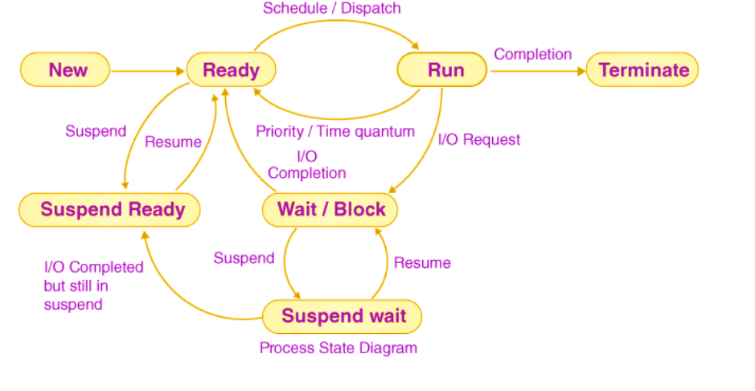

Slide 14
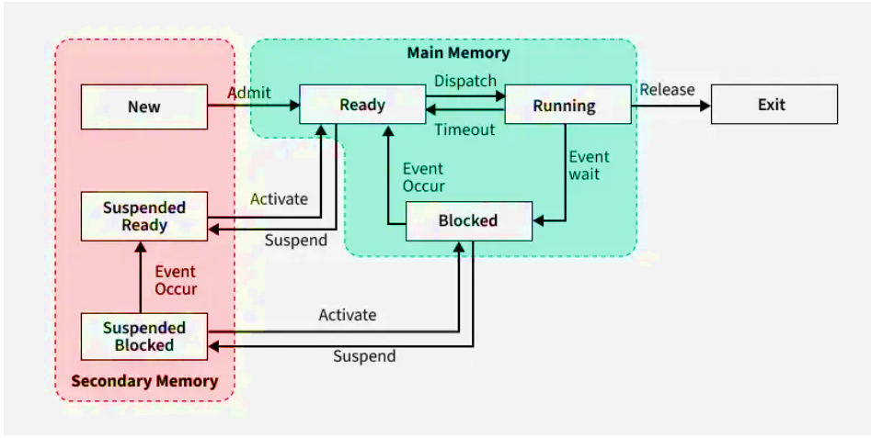

Slide 15
Thank you!
Operating systems may run computers, but curiosity runs innovation

